Slide 1
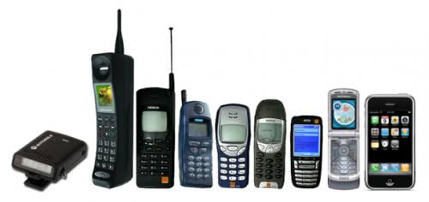
MOBILE PRICE CLASSIFICATION
Presented by:
Lokesh Rajagopal
Venkatesh M
Mansa Dharini
Padmasaran S

Slide 2
PROBLEM STATEMENT
A newly launched mobile company wants to determine the relation between features of a mobile phone (RAM, internal memory etc.) and it’s selling price and determine the price range for the mobile phones to be launched.

Slide 3
DATA DESCRIPTION
Performance related Features
battery_power | Total energy a battery can store in one time measured in mAh
alk_time | longest time that a single battery charge will last when you are
clock_speed | Speed at which microprocessor executes instructions
n_cores | Number of cores of processor
RAM | Random Access Memory in Megabytes
int_memory | Internal Memory in Gigabytes
Physical features
Fc | Front Camera mega pixels
pc | Primary Camera mega pixels
px_height | Pixel Resolution Height
px_width | Pixel Resolution Width
Touch_screen | Touch screen or not
mobile_wt | Weight of mobile phone
c_h | Screen Height of mobile in cm
sc_w | Screen Width of mobile in cm
m_dep | Mobile Depth in cm
Network related Features
dual_sim | Has dual sim support or not
four_g | Has 4G or not
three_g | Has 3G or not
Blue | Has Bluetooth or not
Wifi | Has wifi or not
Dataset size:
2000 rows and 21 features

Slide 4
FEATURE ENGINEERING
Screen size
Column ‘screen size’ was created combining screen height and screen width
PPI
Column ‘PPI’(Pixels Per Inch) was created combining pixel height and pixel width along with screen size
4G/3G
Columns 3G and 4G were combined to create column ‘4G/3G’

Slide 5
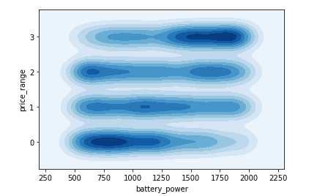
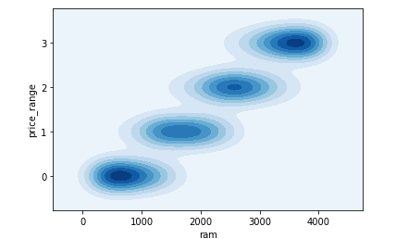
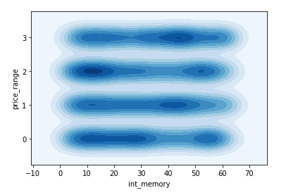
EXPLORATORY DATA ANALYSIS

Slide 6
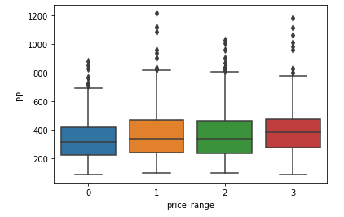
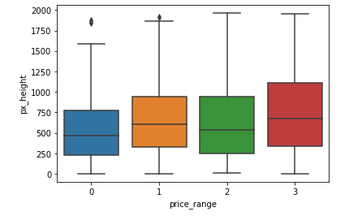
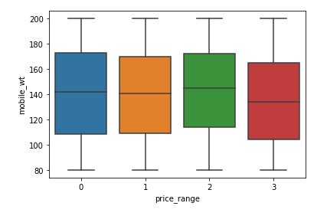
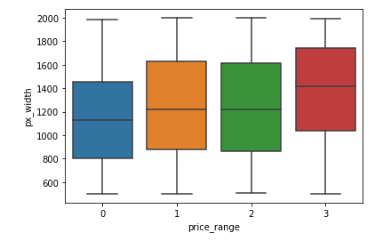
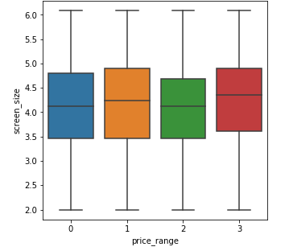

Slide 7
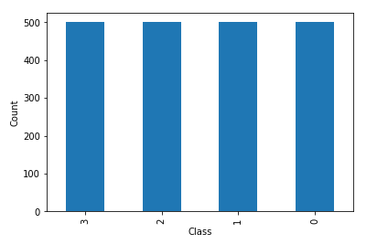
CHECKING DATA IMBALANCE
With 4 classes to be classified, this is a multi class classification problem.
Since our data is balanced, the metric used is accuracy.

Slide 8
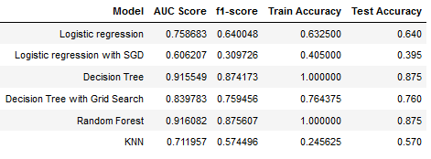
MODELLING
WITHOUT FEATURE SELECTION

Slide 9
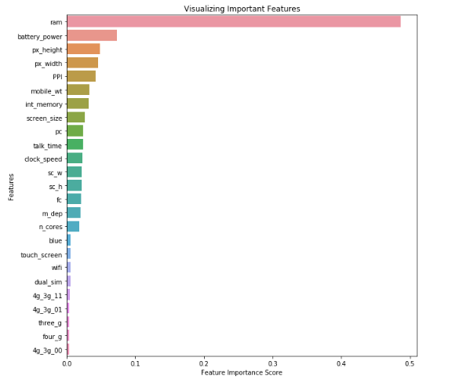
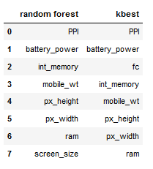
FEATURE SELECTION

Slide 10
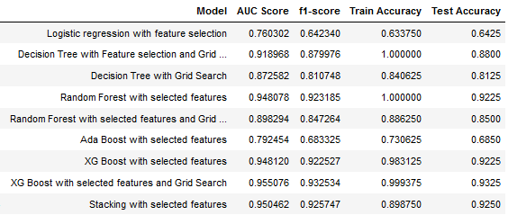
MODELLING
AFTER FEATURE SELECTION

Slide 11
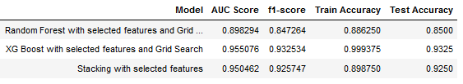
BEST PERFORMING MODELS
From the above table, it is evident that the best model is Stacking Classifier with an accuracy of 92.50%.
The algorithms used in stacking classifier are:
Random Forest, Decision Tree and XG Boost Classifier on the first level
XG Boost Classifier on the second level.

Slide 12
Low performing algorithms
KNN
Logistic Regression
Random forrest
XGBoost
Decision Tree
High performing algorithms

Slide 13
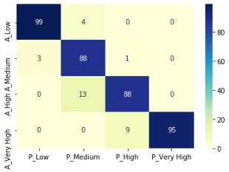
CONFUSION MATRIX OF BEST MODEL
As discussed in EDA, price range low and very high are accurately classified whereas the medium and high price ranges seem be a bit difficult to categorise.

Slide 14
CONCLUSION
The price range of mobiles is thus determined and the most important features are shown in the image to the right.
Most expensive/flagship phones as well as low-end phones can be well classified but there are minor overlaps in budget and mid range phones.
Price
Battery power
Internal memory
PPI
RAM

Slide 15
SOURCE
https://www.kaggle.com/iabhishekofficial/mobile-price-classification

